Slide 1
GSM Networks

Slide 2
GSM
Global System for Mobile Communications
NMT = Nordic Mobile Telephone
AMPS = Advanced Mobile Phone System
GSM = Global System for Mobile communication
CSD = Circuit Switched Data
HSCSD = High Speed Circuit Switched Data
GPRS = General Packet Radio Service
EDGE = Enhanced Data Rates for GSM Evolution
UMTS = Universal Mobile Telecommunication System
LTE = Long Term Evolution
 | 1G | 2G | 2.5G | 3G | 4G
Timeline | ‘80 | ‘90 | ‘00 | ‘02 | ‘08
System | NMT, AMPS | GSM/CSD | HSCSD, GPRS, EDGE | UMTS | LTE
Transfer | - | kb/s | x | 384 kb/s | 300Mb/s

Slide 3
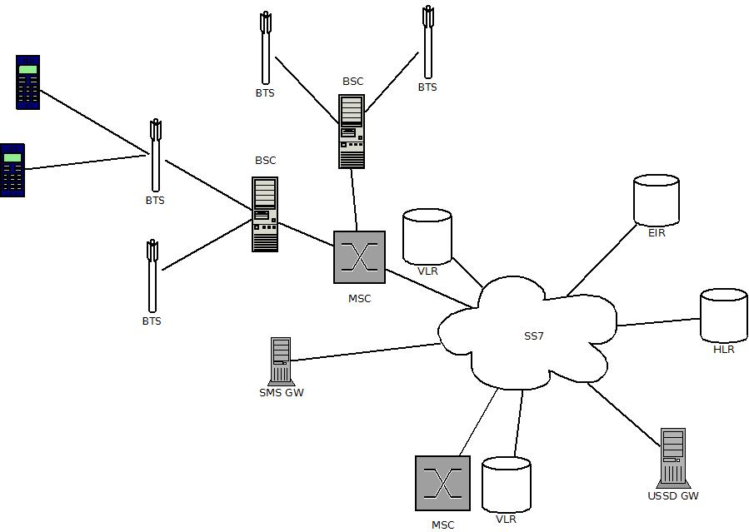
GSM architecture

Slide 4
Acronyms
MS – Mobile Station
BSS – Base Station Subsystem
BTS – Base Transceiver Station
BSC – Base Station Controler
NMS – Network Management System
NSS – Network & Switching Subsystem
MSC– Mobile Switching Center
GMSC – Gateway Mobile Switching Center
HLR – Home Location Register
VLR – Visitor Location Register
AuC – Authentication Center
EIR – Equipment Identity Register

Slide 5
Network Areas
Cell
One BTS covers one cell
Identified by Cell Global Identity
Location Area
A group of cells served by BTSs controlled by one BSC
MSC/VLR Service Area
Area covered by one MSC
PLMN
Whole area covered by one network operator is the Public Land Mobile Network

Slide 6
Mobile Station
Physical device:
Radio transceiver
Display + keyboard, battery ..
SIM card
Subscriber Identity Module
Subscriber identification
addressing information
Functions
Voice services
Data bearer services
Supplementary services

Slide 7
Base Station Subsystem (BSS)
Base Transceiver Station (BTS)
Connects the Mobile Station to the cellular network
Handles radio interface protocols
Modulates, demodulates and ciphers
Physically: Antennas + transceiver
Serves a Cell
Base Station Controller (BSC)
Controls a group of BTS
Manages radio resources – e.g. allocates communication channels, handovers, power control, signal quality

Slide 8
Networking Switching Subsystem (NSS)
The Core Network
MSC + VLR + HLR + other nodes connected to those via signaling protocols

Slide 9
HLR
Home Location Register
Database and Service
Subscriptions
Administrative information
IMSI + MSISDN
Supplementary services
Basic service subscription information
Service restrictions – e.g. roaming permission, call barring..
Location information
Registers users in the network
Holds location information of mobile stations under the form of the VLR address of the VLR that currently serves a the subscriber

Slide 10
VLR
Visitor Location Register
To a certain extent it is a cache of HLR
Contains a subset of administrative information necessary for call control of mobile stations within the are controlled by the VLR
Data stored only while subscriber is in the area
Subscriber profile
Authentication data
Special numbers IMSI, TMSI, MSRN
Each MSC has a VLR, usually in the same box
Does
Location update when subscriber enters the area
Removes data when subscriber exits the area
Manages local subscriber data

Slide 11
EIR
Equipment Identity Register
Allows/disallows a certain mobile equipment in the network
Mobile equipment is identified by IMEI – International Mobile Equipment Identity
Lists of IMEI numbers
White list – accepted device list
Black list - blocked devices due to stolen, fraud, etc.
Grey list - incompatible devices, bugs, etc.

Slide 12
AuC
Secure database holding secret keys
Secret key is stored both places:
In the SIM module
In AuC database
Does:
Authentication
ciphering

Slide 13
MSC
Mobile Switching Centre
More BSC are connected to one MSC
Responsible with:
Routing of incoming/outgoing calls
Billing (CDR – call detail record)/authorization of calls
Handling mobile station management:
Registration
Authentication
Location update
Handovers
Call routing

Slide 14
GMSC
GMSC
Gateway MSC
Link to other networks mobile or not
Terminates calls

Slide 15
Addressing
GSM
User != Equipment
User subscribes to multiple services
Designed for security up to a certain extent
Subscriber Id != phone number

Slide 16
Addressing - IMEI
International Mobile Station Equipment Identity
Identifies the equipment
Allocated by manufacturer
Registered by the network and stored in EIR in order to recognize equipment as:
Compatible/incompatible
Old or obsolete
Stolen!
IMEI = TAC + FAC + SNR + SP
TAC – Type Approval Code 6 decimal, e.g. 10,20 – Nokia; 51 - Sony
FAC – Final Assembly Code 6 decimal
SNR - Serial Number 6 decimal
SP – Spare 1 decimal
Theoretically should be unique
Practically: India 2012 - 18000 devices with the same IMEI were found
Exercise : dial *#06# on your phone to get your IMEI

Slide 17
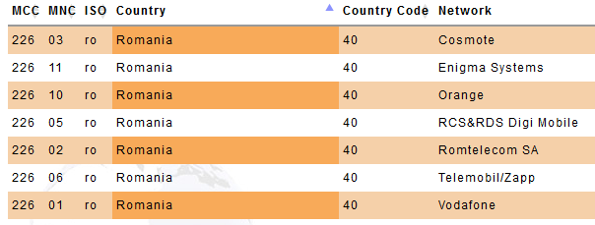
Addressing - IMSI
International Mobile Subscriber Identity
Identifies the Subscriber
Stored in SIM card and HLR
IMSI = MCC + MNC + MSIN
MCC – Mobile Country Code 3 decimal
MNC – Mobile Network code 2 decimal
MSIN – Mobile Subscriber Identification Number 10 decimal(identifies the subscriber)

Slide 18
Addressing - MSISDN
Mobile Subscriber ISDN Number (ISDN = Integrated Services Digital Network)
This is the telephone number
One phone - many SIM cards
One subscriber identified by one IMSI can hold more MSISDN for different services
IMSI,MSISDN pair is stored in HLR
MSISDN = CC + NDC + SN
CC – Country Code max 3 digits
NDC – National Destination Code max 3 digits
SN – Subscriber Number max 10 digits

Slide 19
Addressing - MSRN
Mobile Station Roaming Number
Temporary ISDN number assigned by the VLR to the mobile station based on location
Same structure as MSISDN
Allocation of MSRN by VLR:
On registration when entering a new Location Area;
As per HLR request
Dynamically at call setup
MSRN is further stored in HLR
Used for routing calls to the mobile station
Hides the real MSISDN for traffic sniffers

Slide 20
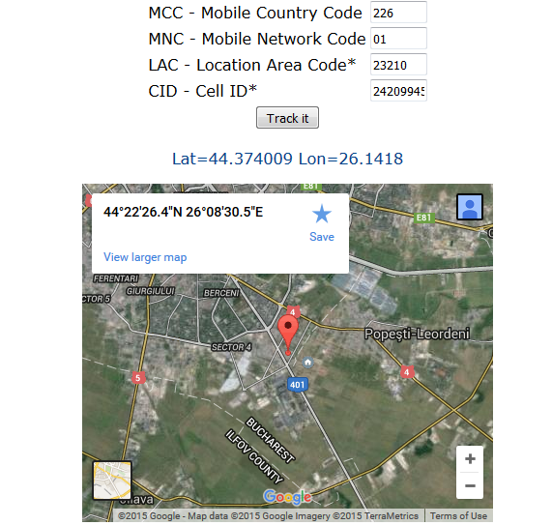
LAI
Location Area Identity
Each Location Area in the PLMN has an ID
LAI = CC + MNC + LAC
CC – Country Code 3 digits
MNC – Mobile Network Code 2 digits
LAC – Local Area Code 5 digits
Notes:
http://cellphonetrackers.org/gsm/gsm-tracker.php
http://www.cell2gps.com/

Slide 21
Addressing – TMSI
Temporary Mobile Subscriber Identity
Assigned by the VLR
Stored only in VLR
Stored in Mobile Station
Only local significance at VLR service area and only for how long subscriber is handled by this VLR
Used to hide the identity of the subscriber if radio channel is listened to
Along with Location Area Information uniquely identifies the subscriber (TMSI, LAI)
LMSI – Local Mobile Subscriber Identity – can be assigned by VLR as an additional search key to speed up database searches

Slide 22
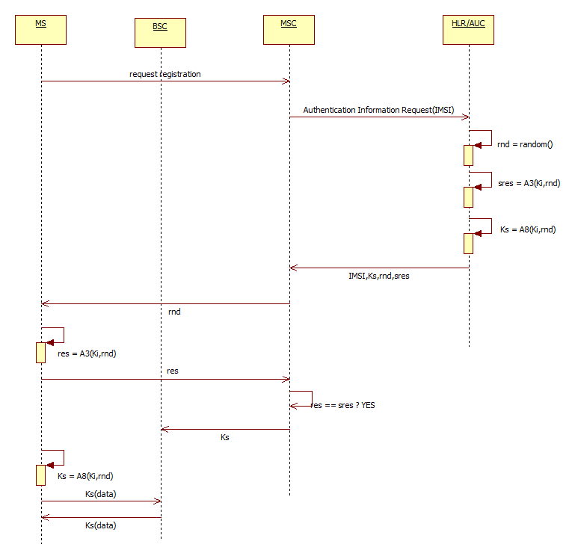
Authentication of Mobile Station

Slide 23
Authentication
Mobile Station requires to attach to the network
Mobile Station and AUC share the same secret key Ki
MSC sends the AUC the IMSI of the subscriber
The AUC computes and sends back to MSC:
A random number to be used as challenge (rnd)
The response to the challenge (sres)
A session key (Ks)
MSC challenges the MS with the random
MS computes the response to the challenge (res) and sends it to MSC
MSC checks if res==sres
If so, the MS is allowed in the network
MS can easily derive session key itself (Ks); MS switches to ciphering mode
Ks is used to encrypt communication radio between MS and network using A5 algorithm

Slide 24
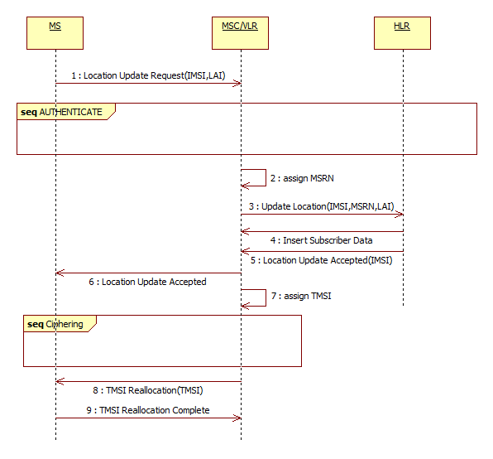
Location Update - attach

Slide 25
Location Update - attach
MS wants to register at current location and sends a request with its IMSI and LAI (MCC+MNC+LAC)
Authentication takes place as presented
MSC/VLR assign a MSRN to the MS and update HLR with new identification information
HLR sends VLR subscriber data for local caching
HLR confirms to MSC, and MSC confirms to MS
VLR generates TMSI for subscriber
After ciphering the connection, the TMSI is updated into the MS; this way TMSI is not compromised

Slide 26
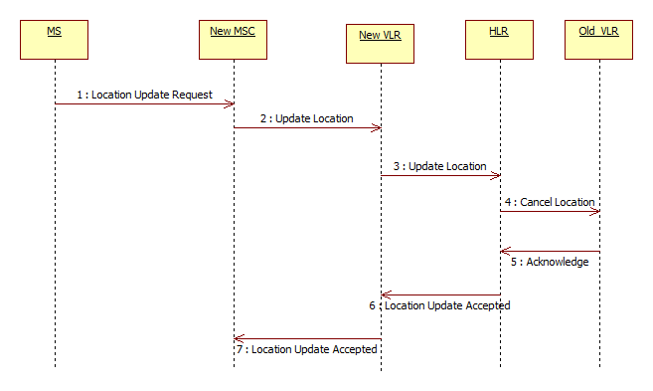
Location Update – when moving

Slide 27
Location Update
When subscriber enters an area covered by other MSC/VLR
VLR finds no record of MS; asks to HLR to give details and update location
HLR sends subscriber data to VLR for local storage and
HLR instructs the old VLR to forget the MS
The rest of the flow is the same as for the area

Slide 28
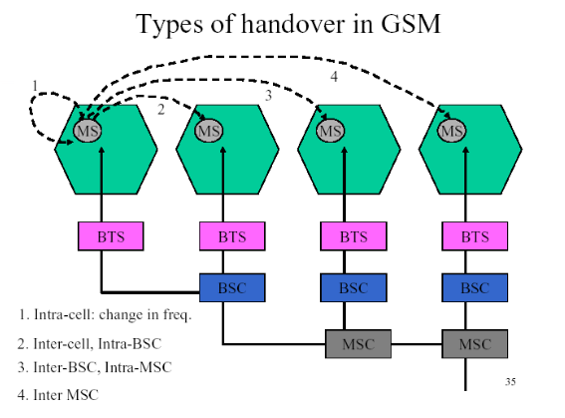
Handovers
1,2 involves BSC
3 involves MSC
4 involves MSC, HLR (Location Update)

Slide 29
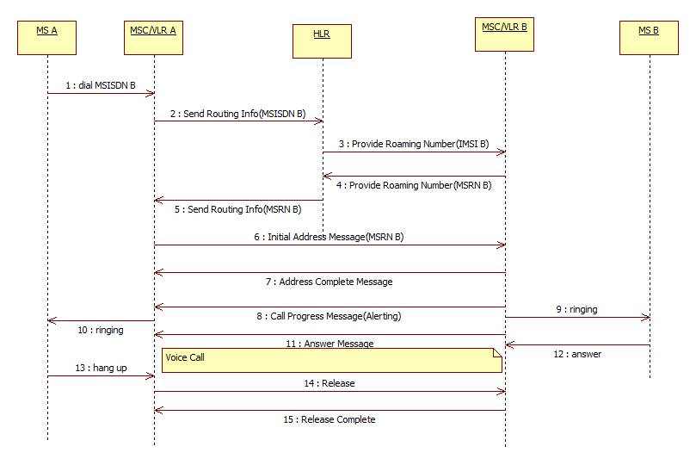
Voice Calls
Mobile to Mobile same network different MSC

Slide 30
Voice Call
A Party diales number MSISDN B
SRI Request – MSC of A Party asks HLR how to address dialed number; HLR knows location information therefore knows MSC/VLR of B, i.e MSC/VLR B
Provide Roaming Number Request – HLR asks VLR B about MSRN of B
SRI Response – MSC A is informed how to reach MS B, i.e. what MSC, what MSRN
A connection is established between the MSC A and MSC B
Initial Address Message – MSC A dials the MSRN B directly to MSC B, informing that A Party wants to call B
Alert – notify that MS B is ringing, A is also played the ring tone
Answer– MS B answers the phone; voice channels are connected
Release – one of the parties hangs up

Slide 31
Roaming
HPLMN
VPLMN – Visited Country
GMSC
HLR
GMSC
MSC
HLR
MSC
VPLMN – Home Country
GMSC
PLMN – Public Land Mobile Network
HPLMN – Home PLMN (Home network of SIM card)
VPLMN – Visited PLMN (Visited foreign network)
HLR
MSC

Slide 32
Roaming
PLMN – Public Land Mobile Network
HPLMN – Home PLMN (Home network of SIM card)
VPLMN – Visited PLMN (Visited foreign network)
User attaches to:
HPLMN
VPLMN – home – i.e. local roaming
VPLMN – foreign country – i.e. roaming abroad
In roaming participate:
HLR in HPLMN
VMSC in VPLMN
To make roaming happen:
Operators must sign agreement
Networks must be properly configured
Roaming service must be activated for given subscriber (HLR profile)

Slide 33
UMTS Network (3G)
UMTS = Universal Mobile Telecommunications System
new technologically more advanced and more effective access to network – Wideband CDMA
troughput for user up to 2Mbit/s
Completely different access technology
Different BTS (Node-B)
Different BTS controllers (RNC)
Different user terminals (supporting two systems)
Voice codecs with adaptive coding (AMR)

Slide 34
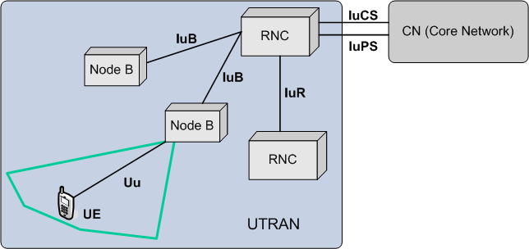
UMTS Network Diagram

Slide 35
UTRAN
Node B
Analogue to BTS
Radio signal processing
Modulation/demodulation
Managing radio resources
Power control
Signal measurement / error rate
RNC (Radio Network Controller)
Analogue to BSC
Soft handover
Ciphering
Location of terminals
Interfaces
IuPS – packet network connections
IuCS – voice network connections

Slide 36
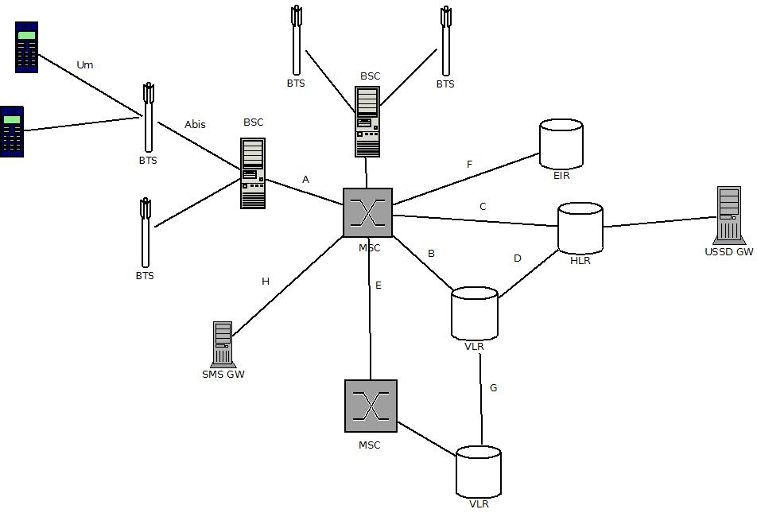
GSM Interfaces

Slide 37
GSM Interfaces Review
Um – MS to BTS radio interface
Abis – BTS to BSC – radio equipment control and
A – BSS to MSC channel management
B – MSCtoVLR – MSC interrogates VLR about MS in the area; protocol is MAP/B (SS7)
C – HLR to GMSC – exchange routing information; protocol is MAP/C
D – VLR to HLR; protocol is MAP/D for location exchange
E – MSC to MSC; handover and relay; protocol is MAP/E
F – MSC to EIR; check IMEI status
G – VLR to VLR; location update; protocol is MAP/G
H – MSC to SMS Gateway
HLR to USSD Gateway is also MAP based

Slide 38
Security review
Subscriber authentication (algorithm A3, A8)
Network authentication (only UMTS, optional)
Signaling and voice ciphering (algorithm A5)
Controlling of used terminals (HLR, EIR)
Controlling of access to terminal – PIN code (ang. Personal
Identification Number)
Access to operator network for legal authorities (LI – ang. Lawfull
Interception)
Physical access to network elements
Using IPSec to secure IP links (sigtran)

Slide 39
GPRS
General Packet Radio Service
Packet oriented data service – Packet transmission in radio link
Costs are dependent on data volume not duration
Mobile network is transparent to various IP networks
Services
SMS
MMS
Internet access, Facebook, VPN

Slide 40
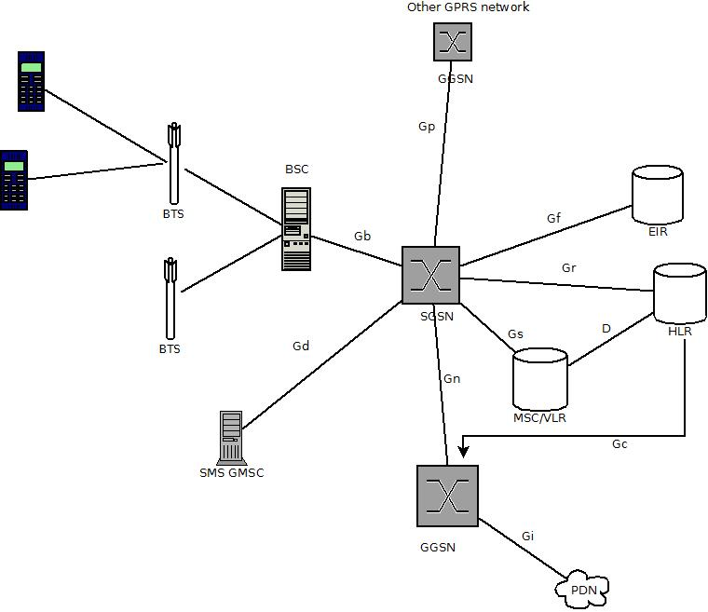
GPRS Architecture

Slide 41
SGSN
Serving GPRS support node
Tasks:
Security – encryption
Data is encrypted between mobile station and SGSN
Routing packets
Mobility handling, e.g. handover
Records charging information

Slide 42
GGSN
Gateway GPRS support node
Gateway
Router
Firewall
Authenticates user
Charging info
IP address assignment

Slide 43
GPRS Call
Subscriber wants to access Internet
Subscriber has set up on phone upon subscription:
APN (Access Point Name)
Ex. Postpaid.operator.ro, prepaid.operator.ro
APN determines:
IP network to which user can connect
Set of parameters used in this connection
Gateway IP

Slide 44
PDP Context
PDP = Packet Data Protocol
PDP context
information about active user session
MS IP Address
GGSN used to access Internet
Steps
Attach to network
Activate PDP context

Slide 45
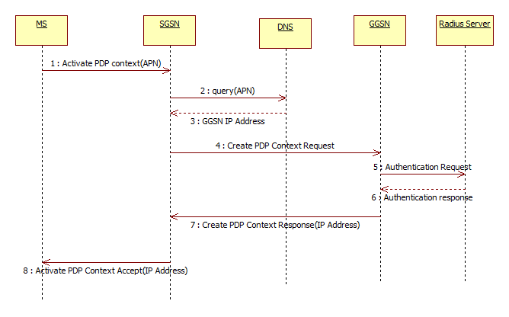
PDP Context Activation

Slide 46
PDP Context Activation
MS initiates procedure to obtain IP address, sends APN as parameter
SGSN queries DNS to find the IP of the GGSN corresponding to APN data
DNS replies with the GGSN IP
SGSN routes PDP creation request to the GGSN
GGSN queries Radius server to authenticate the user
GGSN responds SGSN indicating the procedure finished and an IP has been allocated
SGSN responds the MS with the IP
The MS can now browse

Slide 47
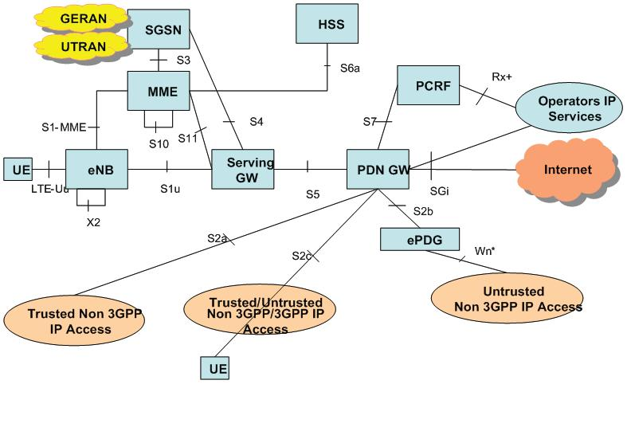
LTE
GERAN – GSM Edge Radio Network (2G)
UTRAN – UMTS Network (3G)

Slide 48
LTE
Long Term Evolution
Optimized for IP services
NO optimization for Voice (fallback to 3G)
MME
Mobility Management Entity
Serves control plane – session and subscriber management
P-GW
PDN (Packet Data Network)
Interface with external IP
Analog to GGSN
S-GW
Serving gateway – interface towards E-UTRAN (radio infrastructure for LTE)
Analog to SGSN
PCRF
Policy and Charging Rules Function
Enforces policies, e.g. throttling download speed
HSS
Equivalent to HLR

Slide 49
Conclusion
In the Core Network most protocols are
SS7 based:
Various MAP
CAP
Diameter

